Slide 1
Creating and Managing Docker Images

Slide 2
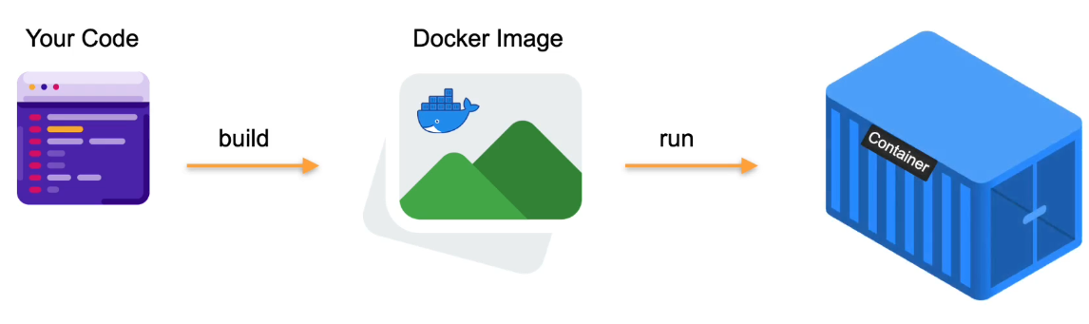
Docker Images and Containers

Slide 3

What are Docker Images
A Docker Image is a file used to execute code in a docker container
It is a set of instructions that allow you to build a docker container
It contains Application Code, Libraries, Tools, and everything needed to run your applications

Slide 4
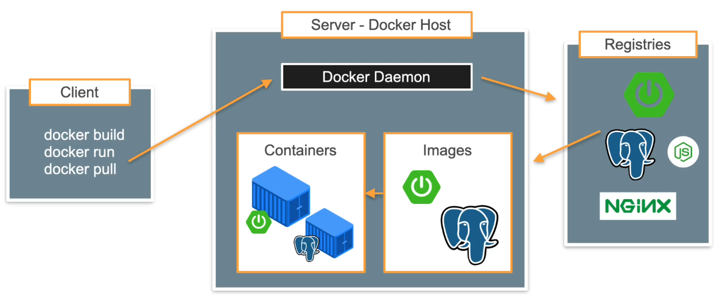
Docker Architecture

Slide 5
Docker Daemon
The Docker client communicates usually with the daemon via the unix socket /var/run/docker.sock
A unix socket is an inter-process communication mechanism that allows bidirectional data exchange between processes running on the same machine.

Slide 6
Creating Docker Images
There are 3 main ways you as a developer can create images
Interactive Image Creation
Using Dockerfiles to Build an Image
Saving and Loading Images

Slide 7
Interactive Image Creation
This image build technique involves running a container interactively with a base image, then generating a new image from the base image
We then use the docker container commit command to generate a new image from our base image

Slide 8
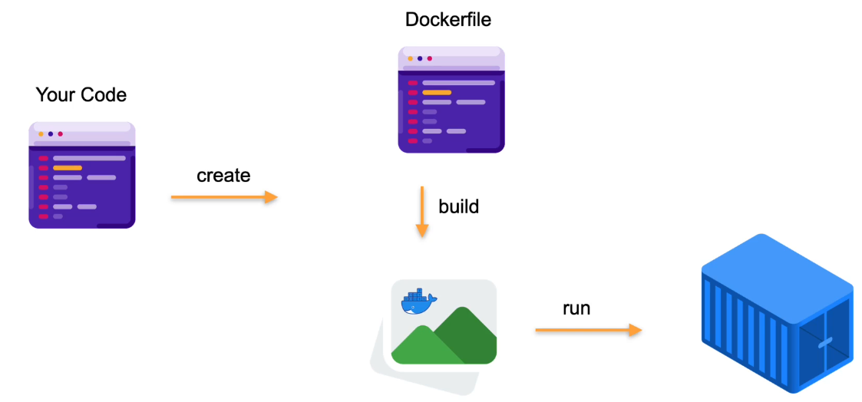
Using Docker File

Slide 9

Understanding Docker Files
It is a set of commands used to assemble a Docker Image

Slide 10
Saving and Loading Images
The third way to create a new container image is by importing or loading it from a file.
You use the docker image save command to export an existing image to a tarball file

Slide 11
Sharing and Shipping Images
Sharing an image involves the following steps
Tagging an image
Understanding of Image namespaces and official images
Pushing images to an image registry

